Slide 1
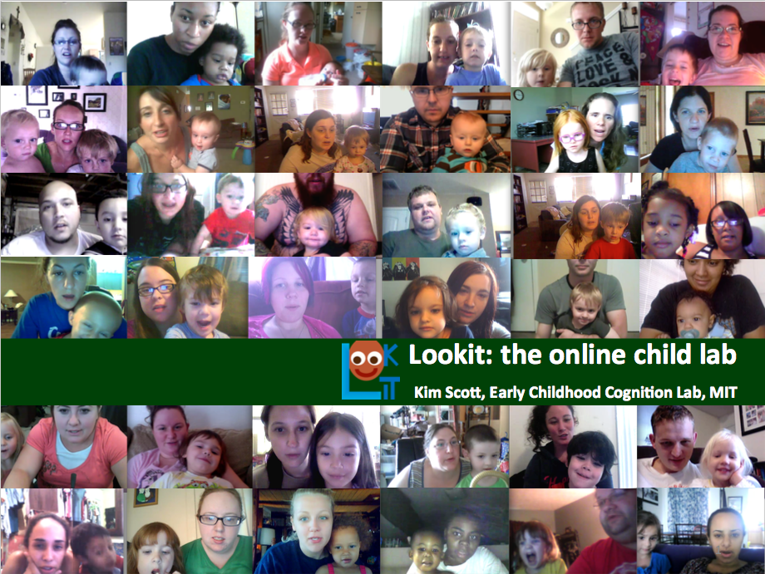

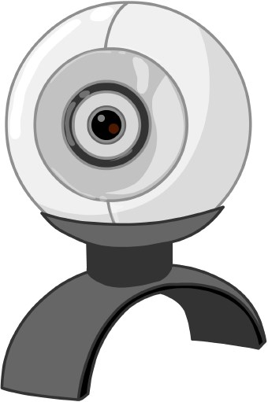

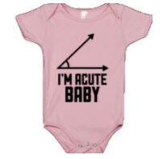

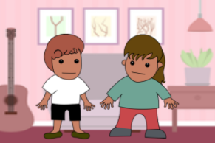


Lookit!
Participate from home:
online studies about child development
Here’s a peek at our current studies:
How it works
Your baby, the physicist
Age range: 4-12 months
Longitudinal (one or more 15-minute sessions)
With Lookit, you and your child can take part in developmental psychology studies from home!
To get started, create an account at https://lookit.mit.edu. Then, you can participate right away – you don’t need an appointment! You and your child will do short activities in a web browser, and webcam videos of your child’s responses will be sent back to the Lookit lab for analysis.
In this study, we’re looking at babies’ understanding of physics principles like gravity, inertia, and support – all the things they’re learning about as they fling food off the high chair. Again.
Baby Euclid
Age range: 6.5 – 7.5 months
One ten-minute session
Your baby probably isn’t ready for geometry class – but he or she is already learning about shapes. In this study, your child will see side-by-side displays of changing triangles. We’re interested in whether 7-month-olds are already especially attuned to changes in angles!
Mind and Manners
Age range: 2, 3, and 4-year-olds
One fifteen-minute session
Early Childhood Cognition Lab
In this study, we’re looking at how children’s understanding of politeness develops. Your child will hear short stories where characters make requests in different ways, and will be asked to point to the character who was more polite.
More coming soon!

Slide 2
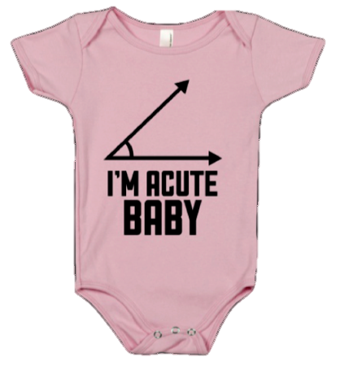
Baby Euclid
Is your baby between 6.5 and 7.5 months old?
Visit http://lookit.mit.edu to participate in a new study, “Baby Euclid”– from home!
Your 7-month-old probably isn’t ready for geometry class – but he or she is already learning about shapes.
In this 10-minute study, your child will see side-by-side displays of changing triangles.
Back in the lab, we measure how long babies look to each display.
We’re interested in whether babies are specifically sensitive to changes in shape.
Participate anytime – no appointments! Webcam videos of your child’s responses will be sent back to the Lookit lab for analysis. For more information, visit https://lookit.mit.edu

Slide 3

Your baby,
the physicist
Is your baby between 4 and 12 months old?
Visit https://lookit.mit.edu to participate in a new study, “Your baby, the physicist” – from home!
In this study, we’re looking at how babies understand physics principles like gravity, inertia, and support – all the things they’re learning about as they fling food off the high chair. Again.
Longitudinal (up to 15 sessions, 10-15 minutes each) to get unprecedented detail about individual children’s looking preferences
Families who complete all sessions will get an individualized report about their child’s looking patterns!
Participate anytime – no appointments! Webcam videos of your child’s responses will be sent back to the Lookit lab for analysis. For more information, visit https://lookit.mit.edu

Slide 4
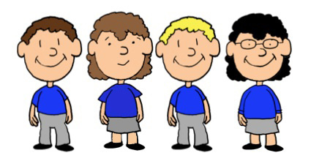
Flurps and Zazzes
Is your child between 3 and 7 years old?
Visit to https://lookit.mit.edu to participate in a new study, “Flurps and Zazzes”—from home!
Every day, you and your child encounter all kinds of people. As an adult, you make a lot of inferences about how those people act and feel. Have you ever wondered if your child does the same thing?
The study takes about 10 minutes. Your child will watch and listen to a story about some children.
Your child will hear questions about the story, and can speak out loud or point to the screen to answer.
Participate anytime – no appointments! Webcam videos of your child’s responses will be sent back to the Lookit lab for analysis. For more information, visit https://lookit.mit.edu

Slide 5
&
Mind
Manners
Is your child between 2 and 4 years old?
Visit to https://lookit.mit.edu to participate in a new study, “Mind and Manners”—from home!
Learning to be polite is a lifelong journey for most of us – and it’s not just a matter of saying please and thank you (although those go a long way). Wondering what your child is learning as you tell him or her to ask nicely?
This study takes about 10 minutes.
Your child sees and hears short stories about two characters.
After each story, your child answers a question about the characters by pointing.
We’re interested in how kids learn what it means to be polite.
Participate anytime – no appointments! Webcam videos of your child’s responses will be sent back to the Lookit lab for analysis. For more information, visit https://lookit.mit.edu

